Slide 1
Floating-point Numbers and Bitfields
CS 0447
Jarrett Billingsley

Slide 2
Class announcements
:B

Slide 3
Fractional numbers

Slide 4
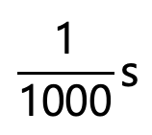
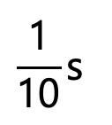
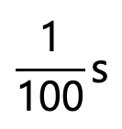
Fractional places
fractional places are negative powers of the base.
you might have learned these as “decimal places” or “decimals” but let’s use the term “fractional places” because otherwise it gets real confusing if you say “decimals” when using binary. aaaaaaaaaaaaa
because we are using decimal, this is called the decimal point, but it has other names in other bases.
1.234
$$\frac{\text{1}}{\text{10}}\text{s}$$
$$\frac{\text{1}}{\text{100}}\text{s}$$
$$\frac{\text{1}}{\text{1000}}\text{s}$$
1s
10⁰
10⁻¹
10⁻²
10⁻³

Slide 5
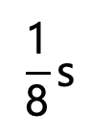
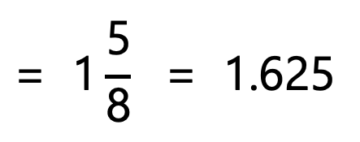
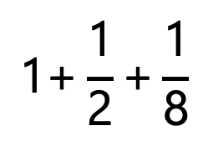
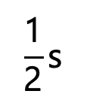
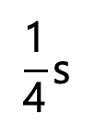
Fractional places, in binary
of course this works fine in binary too.
1.101
converting to base 10 still works the same way: add the values of the places where you see 1s.
2
$$\text{1+}\frac{\text{1}}{\text{2}}\text{+}\frac{\text{1}}{\text{8}}$$
$$\text{= 1}\frac{\text{5}}{\text{8}}\text{ = 1.625}$$
$$\frac{\text{1}}{\text{2}}\text{s}$$
$$\frac{\text{1}}{\text{4}}\text{s}$$
$$\frac{\text{1}}{\text{8}}\text{s}$$
1s
(note that 101₂ = 5₁₀, and the smallest place is the 8ths, so that’s a quicker way to do the conversion.)
2⁰
2⁻¹
2⁻²
2⁻³
binary point!
Notes:
- it’s just like in base 10, if you see 1.234, you know the 4 is the 1000ths place, so the fraction is 234/1000. same deal.

Slide 6
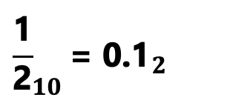
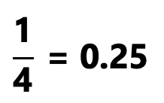
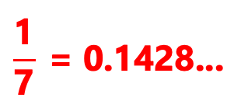
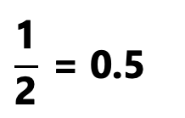
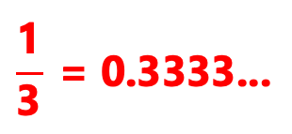
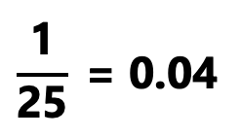
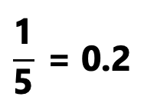
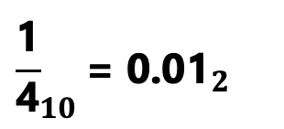
(Non-)terminating decimal-fractional expansions
In any base, only fractions whose denominators are composed of prime factors of the base will terminate.
in base-10, that means fractions with denominators of the form 2^{x}5^{y}
$$\frac{\text{1}}{\text{2}} \text{= 0.5}$$
in base-2, only fractions whose denominators are powers of 2 terminate.
$$\frac{\text{1}}{\text{4}} \text{= 0.25}$$
$$\frac{\text{1}}{\text{3}} \text{= 0.3333...}$$
$${\frac{\text{1}}{\text{2}}}_{10}\text{= }{\text{0.1}}_{2}$$
$${\frac{\text{1}}{\text{10}}}_{10}\text{= }{\text{0.}\text{000}\text{1}\text{10011}...}_{2}$$
$$\frac{\text{1}}{\text{5}} \text{= 0.2}$$
$${\frac{\text{1}}{\text{4}}}_{10}\text{= }{\text{0.}\text{0}\text{1}}_{2}$$
$$\frac{\text{1}}{\text{7}} \text{= 0.1428...}$$
$$\frac{\text{1}}{\text{25}} \text{= 0.04}$$

Slide 7
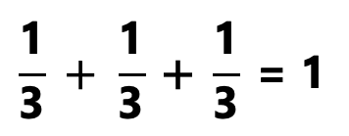
Imperfect
we work with infinitely repeating decimals in math just fine, right?
$$\frac{\text{1}}{\text{3}} + \frac{\text{1}}{\text{3}} \text{+ }\frac{\text{1}}{\text{3}} \text{= 1}$$
but this is just a notational thing. we “know” that these decimals “go on forever” even if we don’t write infinite digits.
$$\text{0.}\overline{\text{3}} \text{+} \text{0.}\overline{\text{3}} \text{+} \text{0.}\overline{\text{3}} \text{= 1}$$
what if we were forced to represent these as finite sequences of digits?
$$\text{0.333 + }\text{0.333}\text{ + }\text{0.333}\text{ = }\text{0.999 }\text{≠ 1}$$
$$\text{0.667 + }\text{0.}\text{667 + }\text{0.}\text{667 = }\text{2.001 }\text{≠ 2}$$
this is not an issue of ”accuracy.” no finite number of fractional places can represent infinite fractions, because writing infinite fractional places would require infinite storage.

Slide 8
Okay so how are floats represented
essentially, as a fixed-length binary number with fractional places.
1.0001 1001 1001 1001 1001 100
that’s it. that’s all you get. no more! if it repeats, it gets cut off.
hey, what’s 0.1 + 0.1 + 0.1?
System.out.println(0.1 + 0.1 + 0.1);
=> 0.30000000000000004
this is not a bug. this is not a problem with Java, or Python, or any other programming language. this is a simple consequence of the way floats are represented.

Slide 9
Gee, where do tenths and hundredths come up?
one of the most common applications of decimal fractions in everyday life is money, and unfortunately, floating-point numbers are entirely unsuited to doing calculations on money.
NEVER USE FLOATS FOR MONETARY CALCULATIONS. NO, NOT EVEN DOUBLES. MORE ACCURACY ≠ CORRECT.
money is in base 10, and floats are not
so to do monetary calculations, you have to do them in base 10.
Java has the BigDecimal class for this
most popular programming languages have libraries for it

Slide 10
There are other issues
because floats are a finite number of digits, every operation on floats rounds the result off to the nearest representable float.
this has a really nasty consequence:
(a + b) + c may not be equal to a + (b + c)!
because (a + b) + c is really done as:
round(round(a + b) + c)
by the way the operation of that round() function depends on the value of a global register in the CPU and different pieces of code interacting may not expect this and it can wreak absolute havoc :))))))))))

Slide 11
Ok but how do we actually represent floats

Slide 12
Another world
to represent numbers with places after the decimal (or binary) point…
+1.5
-0.000000000001
+9.581977
-3.994
+99030000000.0
there is a lot of variation in the magnitude of these numbers, but we always have to keep track of three things:
1. the sign
2. the digits
fortunately, scientists have been doing this for a while, and have a useful system for this.
3. the position of the decimal point within the digits
Notes:
123, 12.3, and 1.23 all have the same digits, right? the only difference is where the decimal point is located.
and really, that’s why we call “floating point” “floating point.” because the point “floats around” to any position.

Slide 13
Scientific notation refresher
scientific notation expresses numbers like so:
+6.022 × 10²³
sign
exponent
(i.e. position of point)
significand
there is exactly one non-zero digit before the decimal point.
negative exponents are used for numbers smaller than 1.
(with one exception: the number 0)
when you get the reciprocal…
$\frac{1}{x ×{ 10}^{y}}$ = $\frac{1}{x} × {10}^{−y}$
Notes:
- what was this called? the Avocado Number?
- remember… 1/8 is not 8.

Slide 14
How about in binary?
well, computers don’t use base 10. but that’s okay. scientific notation works just as well in base 2.
(but the below writes exponents in base-10 for clarity)
+10010101 =
-0.00101 =
-1001000000000000 =
+1.0010101 × 2⁺⁷
-1.01 × 2⁻³
-1.001 × 2⁺¹⁵
what do you notice about the digit before the binary point?
Notes:
since the rule is “one nonzero digit before the point”, in binary, which is the only digit that’s allowed to be there?

Slide 15
But how do we represent it space-efficiently?
we could represent floats poorly by doing something like…
class BadFloat {
boolean sign;
int significand;
int exponent;
}
each int field takes up 4 bytes; the boolean field takes up 1; and there are hidden fields and alignment involved, so…
one instance of this class may take up 16 to 24 bytes. that’s awful.
in contrast, a float takes up only 4 bytes. but how?
float f = -1.5;

Slide 16
Bitfields

Slide 17
How many bits do you really need?
remember: with n bits we can represent 2^{n} different values.
for the sign… how many bits would it really take to represent it?
just 1 bit, right? 0 for positive, 1 for negative, like integers.
for the exponent… what are the biggest and smallest numbers are you likely to encounter on a regular basis?
the volume of the visible universe is on the order of 2²⁶⁵ m³.
most useful numbers are way smaller, so maybe exponents in the range 2⁻¹²⁸ to 2⁺¹²⁷ are sufficient. how many bits for that?
then, for the significand, uh… well… um…
really, it’s a matter of how much precision you want.
more bits = more precision.
well, let’s target 32 bits total, so 32 - 8 - 1 = 23 bits for the significand.
Notes:
- the visible universe is about 10^80 cubic meters, and the base-2 logarithm of 10^80 is about 265. hence, 2^265.

Slide 18
Taking shape
think back to when we looked at bitsets last time. we encoded multiple separate 1-bit values within one integer.
what if we extended that concept to multiple-bit values?
00111111100000000000000000000000
0
01111111
00000000000000000000000
these are the exponent…
…and these are the significand.
let’s make this the sign bit.
there! just 32 bits, or 4 bytes, for all three values. this is a bitfield.
now think about the bitwise operations. what operations move bits left and right? which operation turns bits on? which turns them off?
Notes:
left and right shift might be useful for, say, moving the exponent to the right so we can “extract” it somehow.
OR turns bits on, by ORing a bit with 1.
AND turns bits off, by ANDing a bit with 0.

Slide 19
Space efficiency isn’t just for fun
why use one integer instead of three? because it's smaller.
smaller data…
takes up less space in memory
takes up less space in cache
extremely important thing in modern CPUs that we talk about in 1541
is faster to move between memory and the CPU
or between the CPU and anything else
is faster to transfer across the internet and other networks

Slide 20
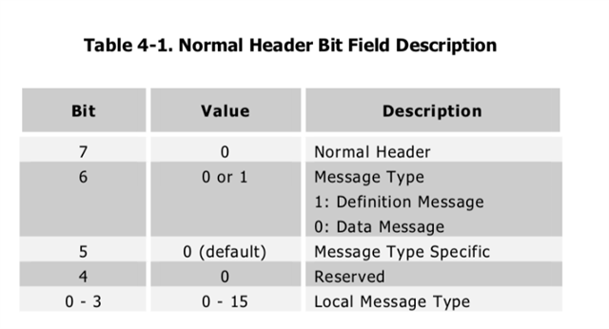
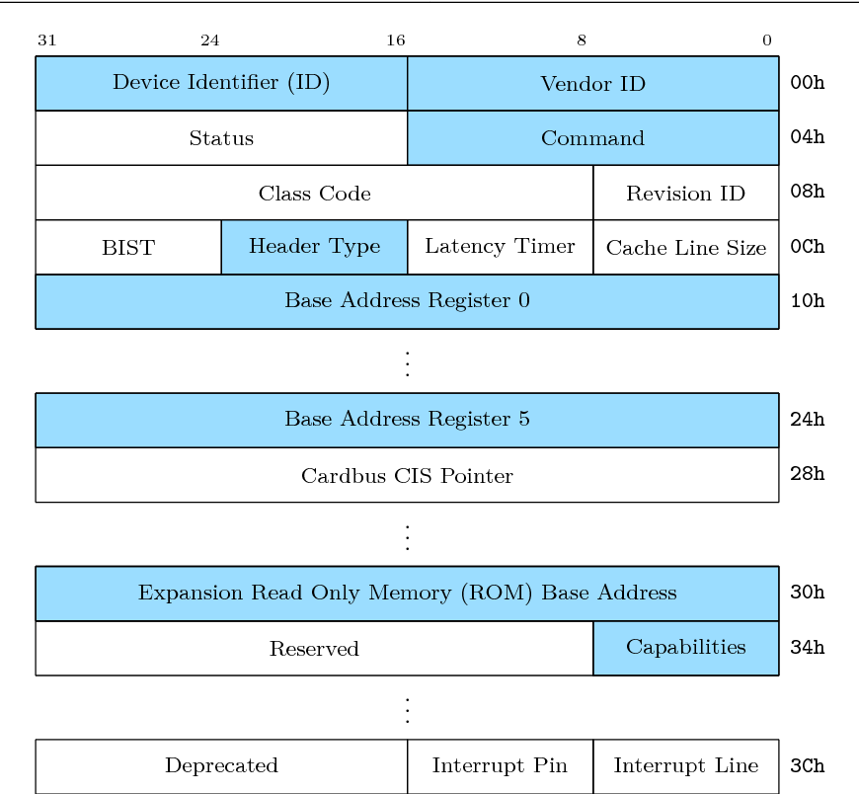
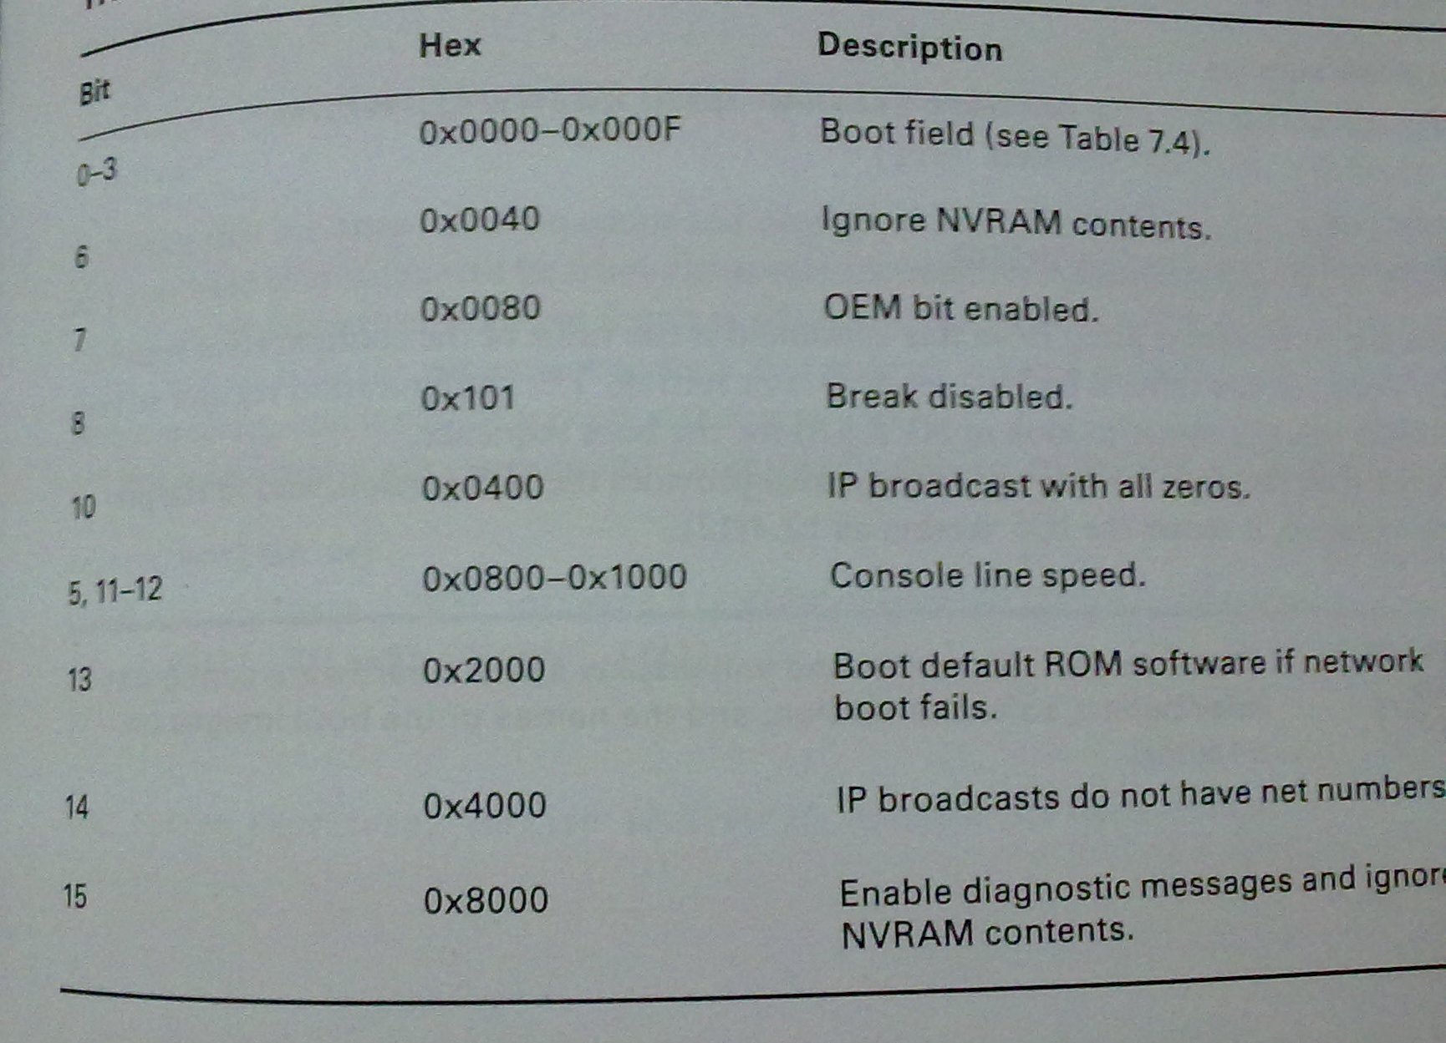
And they're everywhere.
we use bitfields a lot.
binary file formats…
controlling hardware…
CPU machine code…
31 | 26 | 25 | 21 | 20 | 16 | 15 | 11 | 10 | 6 | 5 | 0
opcode |  | rs |  | rt |  | rd |  | shamt |  | funct
31 | 26 | 25 | 21 | 20 | 16 | 15 | 0
opcode |  | rs |  | rt |  | immediate
31 | 26 | 25 |  | 0
opcode |  | target
Notes:
- maybe you took 447 before and learned to encode/decode MIPS instructions.
- that's just one example of bitfields, so I'm teaching you the general technique instead.

Slide 21
IEEE 754

Slide 22
IEEE 754
this is the standard for floats that all CPUs and software now use.
it defines single- and double-precision float formats*.
31 | 30 | 23 | 22 | 0
S | exponent |  | fraction
float
63 | 62 | 52 | 51 | 0
S | exponent |  | fraction
double
the sign and fraction go together. and just like ints, the MSB is the sign.
let's ignore the exponent for now cause it's... weird……………
Notes:
thank god, cause apparently before IEEE 754, it was a huge mess. apparently. I wasn't around for it.
but basically every computer and sometimes every program invented their own ways of representing floating-point numbers and none of them agreed and code that worked fine on one machine would give totally incorrect results on another and aaaaaaaaaaaa!
* …among several others. go look it up if you're curious.

Slide 23
How the sign and fraction fields work
floats don't use 2's complement. they use sign-magnitude.
do you remember the disadvantages and how to negate? (let’s look at FloatBits.java)
the sign goes in the sign field. duh.
the bits after the binary point go in the fraction field, left-aligned.
+1.0010101 × 2⁺⁷
+1.0010101 × 2⁺⁷
31 | 30 | 23 | 22 | 0
0 |  |  | 00000000000000000000000
31 | 30 | 23 | 22 | 0
0 |  |  | 00101010000000000000000
but what about the bit before the binary point?
it's always 1, so we don't store it!
just pretend there's a 1. before the fraction. except for 0.
Notes:
- S-M has two zeroes and more complex/difficult arithmetic.
- negating sign-magnitude is easy: flip the sign bit!

Slide 24
The exponent
the exponent is a completely separate number.
it is also a baffling number. they did this for Sorting Reasons™️.
This…
is stored as…
×2⁰
127
this is biased notation.
×2⁺⁷
134
to get the number you put into the exponent field, you add a bias constant.
×2⁻¹²⁶
1
for single-precision floats, that's 127.
×2⁺¹²⁷
254
Notes:
- using biased (or excess-K) notation for the exponent makes it easier to do comparisons/sorts.
- it also makes it possible to compare/sort floats using integer comparisons. which is neat? hey, it's faster.

Slide 25
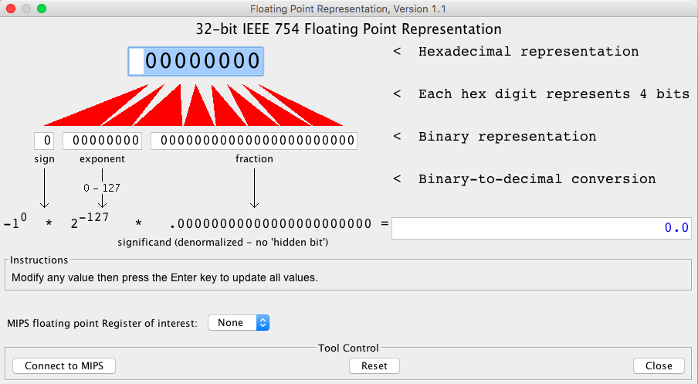
Something to check out in MARS
go to Tools > Floating Point Representation
it's an interactive thing! change any box and hit enter!

Slide 26
Decoding and encoding bitfields

Slide 27
Bitfield specifications
when you want to use a bitfield, you must have a specification for the positions and sizes of each value (each field).
they typically look something like this:
the lower (right) bit number of each field is its position.
31 | 26 | 25 | 21 | 20 | 16 | 15 | 11 | 10 | 6 | 5 | 0
opcode |  | rs |  | rt |  | rd |  | shamt |  | funct
the position is how far you have to shift for that field.
you also need to know the size of the field (in bits).
from the size, you can compute the mask for each field.
Notes:
for the size: remember the inclusive-both-ends-range size? [lo, hi] has (hi - lo + 1) items.
here, opcode/funct are 6 bits; rs/rt/rd/shamt are 5 bits. you figure out the masks! but notice that the mask is just a function of the size – all the 5-bit fields have the same mask, and both the 6-bit fields have the same mask.

Slide 28
Shift'n'mask
here's the specification for our floats:
31 | 30 | 23 | 22 | 0
S | exponent |  | significand?
to extract one field from a bitfield:
1. shift right by its position
2. isolate the lower size bits with a mask
sign = (f >> ) &
31
0x1
exponent = (f >> ) &
23
0xFF
significand = (f >> ) &
0
0x7FFFFF
(shifting right by 0 is optional.)
Notes:
- …… well it’s not actually the whole significand, as we’ll see shortly.

Slide 29
Two bitwise operations down, two to go…
what's the opposite of right shift?
what's the "opposite" of AND?
31 | 30 | 23 | 22 | 0
S | exponent |  | significand
to encode multiple values into a bitfield:
1. shift each field left by its position
2. OR the resulting shifted values together
f = (sign << ) |
(exponent << ) |
(significand << );
31
23
let’s look at Bitfields.java!
0
(shifting left by 0 is optional.)

